Slide 1


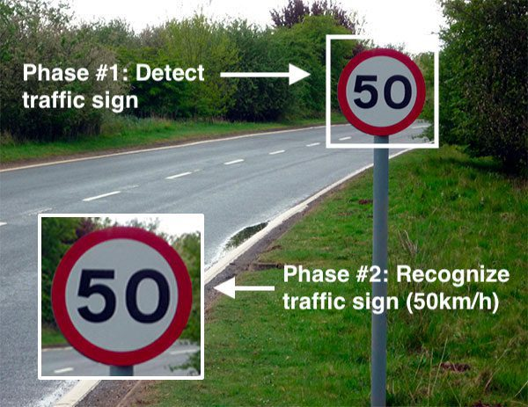
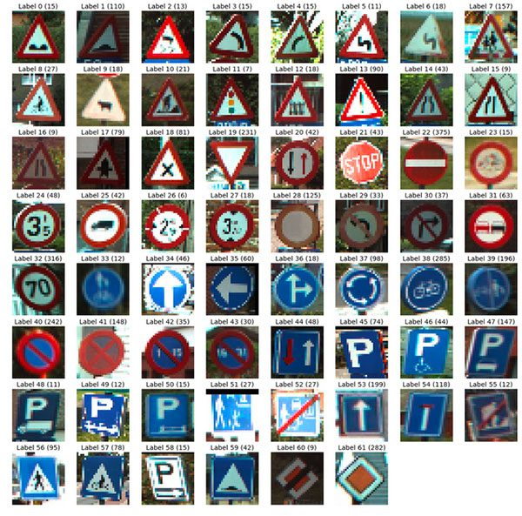
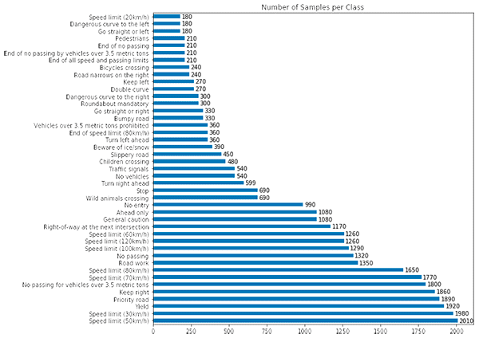
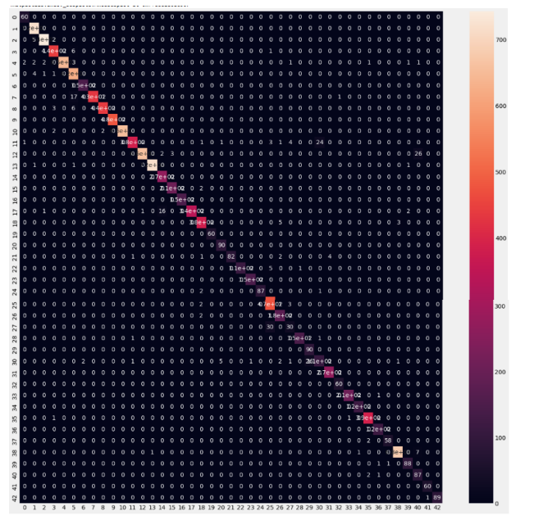
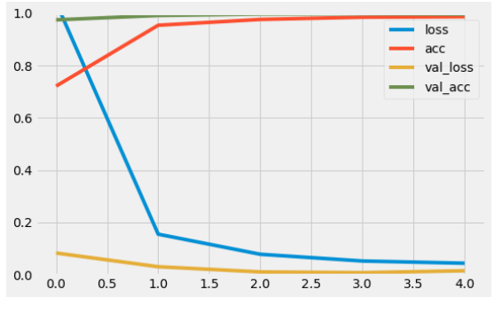
Team AVIDA
Traffic Sign Classifier
John Smith, MD¹; Jane Doe, PhD²; Frederick Jones, MD, PhD^{1,2}
¹University of Affiliation, ²Medical Center of Affiliation
Abstract
Methodology
Conclusions
Discussing and implementing the concept of traffic sign classification and
recognition, using a dataset.
Reviewing our directory structure for the project.
Implementation of TrafficSignNet, a Convolutional Neural Network which will
help in training using our dataset.
Given our trained model, evaluating its accuracy on the test data and even
learn how to make predictions on new input data as well.
Hence our major aim is to build a Road Sign Classifier in Keras or writing a CNN
that classifies over 43 types of road signs in the Keras framework.
1.Importing and loading data-We are using the GTSRB dataset, a dataset with over 50,000 images of German
Traffic Signs. There are 43 classes.
2.Implementing CNN traffic sign classifierwe implement a Convolutional Neural Network to classify and recognize
traffic signs. This set of layers uses a 5×5 kernel to learn larger features —
Implementing our training script-we create our Python
training script that will be responsible for:
• Loading our training and testing split from the GTSRB dataset
• Preprocessing the images
• Training our model
• Evaluating our model’s accuracy
• Serializing the model to disk so we can later use it to make predictions
on new traffic sign data
4.Training our architecture on the traffic sign dataset-
After training our dataset we will achieve results that can be validated using
the accuracy obtained.
5.Implementing our prediction script
Pass our images through our traffic sign classifier
5. Obtain our final output predictions
We learned how to perform traffic sign classification and recognition with
Keras and Deep Learning.
To create our traffic sign classifier, we:
28
• Utilized the popular German Traffic Sign Recognition Benchmark (GTSRB)
as our dataset.
• Implemented a Convolutional Neural Network using the Keras deep
learning library.
• Trained the model on the GTSRB dataset, obtaining a good accuracy.
• Created a Python script that loads our trained model and then classifies
new input images.
Introduction
Results
There are so many different types of traffic signs out there, each with different
colours, shapes and sizes. Sometimes, there are two signs may have a similar
colour, shape and size, but have 2 totally different meanings. To be able to
program a computer to correctly classify a traffic sign on the road we creat our
very own CNN to classify each different road sign.
1.Importing and loading data
2.Implementing CNN traffic sign classifier
Implementing our training script
4.Training our architecture on the traffic sign dataset
5.Implementing our prediction script
6.Make predictions on traffic sign data
Figure 1. Label in 24pt Calibri.
Figure 2. Label in 24pt Calibri.
Contact
References
Team AVIDA
National institute of Technology, Agartala.
Phone:7905155527
https://pyimagesearch.com/2019/11/04/traffic-sign-classification-with-
keras-and-deep-learning/
https://towardsdatascience.com/building-a-road-sign-classifier-in-keras-764df99fdd6a
https://github.com/liferlisiqi/Traffic-Sign-Classifier
https://www.kaggle.com/datasets/meowmeowmeowmeowmeow/gtsrb-german-traffic-sign
https://github.com/DeepranjanG/Traffic_sign_classification
https://youtu.be/Vtc64rPHZ6I
https://youtu.be/tPYj3fFJGjk
https://youtu.be/SWaYRyi0TTs

